Slide 1
A Stock Price Prediction Model Based on Investor Sentiment and Optimized Deep Learning
Welcome to this seminar on an innovative stock price prediction approach.
Presented By: Rahul Kumpawat (PRN21CS080) Guided By: Ms. Suja Vijayan, Assistant Professor, College of Engineering Perumon

Slide 2
Content Page
1
Abstract
2
Introduction
3
Literature Survey
4
Proposed Methodology
5
Data Preprocessing
6
Sparrow Search Algorithm(SSA)
7
Long Short-Term Memory(LSTM)
8
Model Construction
9
Findings
10
Results
11
Future Enhancements
12
Conclusion
13
References

Slide 3

Abstract
1
Accurate Predictions
Our model combines investor sentiment, swarm intelligence, and deep learning to generate highly accurate stock price forecasts.
2
Risk Mitigation
Leveraging these insights can help investors make informed decisions and manage their portfolios more effectively.
3
Enhanced Returns
By identifying undervalued assets and capitalizing on market trends, the model can contribute to increased investment returns.

Slide 4

Introduction
1
Importance of Stock Prediction
Accurate stock price prediction is essential in the financial market, as it enables investors to anticipate market trends, optimize their investment strategies,.
2
Market Behaviour
Analyzing social media, news, and online sources can provide insights into investor psychology and market behavior.
3
Deep Learning
Deep neural networks can extract patterns from large datasets, including investor sentiment, to enhance stock price prediction accuracy.

Slide 5
Introduction (contd)
1
Sentiment Integration
2
Multi-Source Data Fusion
3
Model Training and Deployment
Incorporate investor sentiment data to capture psychological impact on market behavior and enhance prediction.
Integrate financial news, social media, and historical stock data for a comprehensive and robust prediction model.
Develop robust model training and deployment strategies to ensure accurate and reliable stock price predictions.

Slide 6
Literature Survey
1
Forecasting Market Price of Stock Using Artificial Neural Network(A. Murkute and T. Sarode)
This study explore the use of Artificial Neural Networks (ANN) for predicting stock market prices, highlighting their capability to learn from historical data and identify complex patterns.
2
Forecasting Bitcoin Price Using Artificial Neural Network(D. Banjade)
This study applies ANN to the volatile cryptocurrency market, specifically Bitcoin, showing how neural networks can be adapted to forecast prices in highly unpredictable environments.
3
Recurrent Neural Network and a Hybrid Model for Prediction of Stock Returns
(A.M. Rather, A. Agarwal and V. N. Sastry)
This study introduce a hybrid model combining Recurrent Neural Networks (RNN) with other techniques for predicting stock returns, addressing the limitations of traditional neural networks in capturing temporal dependencies.

Slide 7





Proposed Methodology
The MS-SSA-LSTM model adopts a multi-step approach to integrate sentiment analysis and deep learning for stock price prediction.
Data Collection
Gather historical stock prices, financial news, and social media data.
Sentiment Analysis
Extract investor sentiment using NLP and sentiment dictionaries.
Sparrow Search Algorithm(SSA)
Optimizes LSTM model parameters for enhanced predictive accuracy. .
Long Short-Term Memory(LSTM)
A type of recurrent neural network that captures long term dependencies..
Model Training and prediction
Train the MS-SSA-LSTM model, a deep learning architecture combining SSA and LSTM.
.

Slide 8

Data Preprocessing for Stock Price Prediction
Efficient data preprocessing integrates and normalizes data, ensuring consistency for accurate predictions..
1
Data Integration
The model combines multiple data sources including historical trading indicators and sentiment data from online forums. These disparate datasets are integrated into a unified multi-source index matrix.
2
Data Normalization
The raw data is normalized using standard techniques to ensure all features are on a similar scale. This helps the model learn patterns more effectively.
3
Data Division
The preprocessed dataset is then split into training and testing subsets. This allows the model to be evaluated on unseen data to assess its generalization performance.

Slide 9

Sentiment Analysis
1
Sentiment Dictionary
2
Textual Data Analysis
Create a comprehensive dictionary of words/phrases associated with positive, negative, and neutral sentiment.
Analyze news, social media, and online forums to identify prevalent sentiment towards the target stock.
3
Sentiment Quantification
4
Feature Engineering
Calculate a sentiment index to capture the collective mood of investors towards the target stock.
Incorporate the sentiment index as a key feature in the MS-SSA-LSTM model.

Slide 10
Sparrow Search Algorithm (SSA)
Optimizes LSTM hyperparameters for enhanced prediction accuracy.
SSA for Hyperparameter Tuning
Advantages of SSA
Impact on LSTM Performance
Reduces the computational cost of finding the optimal hyperparameter values.
SSA explores the search space to find optimal values for LSTM hyperparameters.
SSA results in an LSTM model with improved prediction accuracy and stability.

Slide 11




Long Short-Term Memory (LSTM) Network
A type of recurrent neural network (RNN) designed to learn long-term dependencies in sequential data.
Input Gate
Controls the flow of new information into the memory cell.
Forget Gate
Determines which information to discard from the cell's memory.
Output Gate
Controls the output of the memory cell based on the
internal state.

Slide 12

Integration of Sentiment Index and Fundamental Trading Data
Sentiment analysis data is combined with fundamental trading data to provide a comprehensive input to the LSTM model.
Sentiment Data
Captures market mood and investor psychology.
Fundamental Data
Includes financial statements, company news, and economic indicators.

Slide 13
Model Construction - MS-SSA-LSTM Stock Price Prediction Model
Data Collection
1
Historical trading indicators and sentiment data from Money forums.
2
Sentiment Analysis
Build a sentiment dictionary, calculate sentiment indicators.
Data Preprocessing
3
Integrate and normalize data into a multi-source index matrix.
4
Parameter Initialization
LSTM and SSA parameter settings.
Model Training
5
Optimize LSTM hyperparameters using SSA and evaluate performance using metrics like MAPE, RMSE, MAE, and R^2.

Slide 14
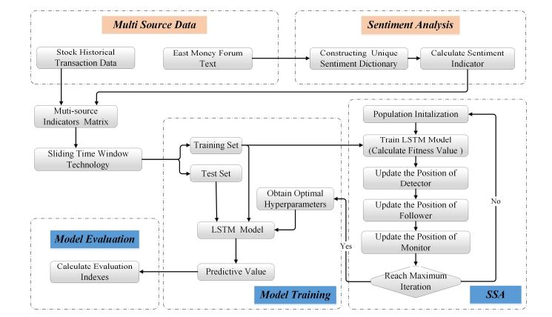
Data Flow Diagram

Slide 15

Findings
1
Multi-Source Data Integration
Combines sentiment, fundamental, and other data to enhance
predictive power.
2
Model Performance
The MS-SSA-LSTM model exhibits strong accuracy and
outperforms traditional approaches.
3
Robustness
Demonstrates resilience to market volatility and economic
conditions for reliable forecasts.
4
Generalizability
Shows applicability across different stock markets and sectors.
5
Role in the International Market
The model has shown promising results in forecasting stock
prices in the International market.

Slide 16
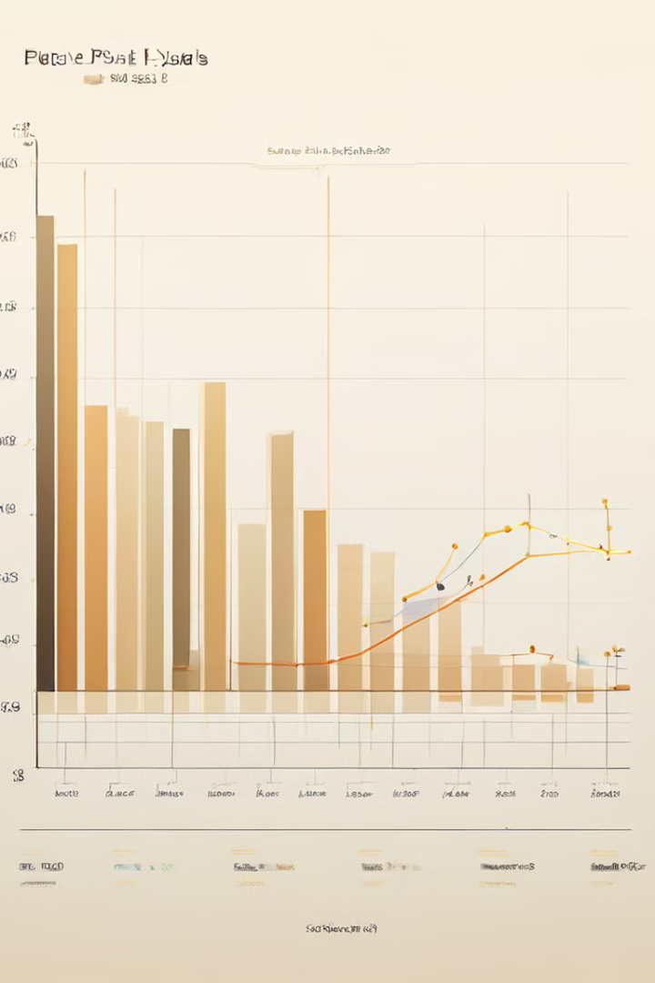
Results
The MS-SSA-LSTM model exhibits significant improvement in
predictive performance.
Enhanced Predictive Performance
Our model leverages sentiment data to improve predictive accuracy.
Optimized LSTM Parameters
The SSA optimizes LSTM hyperparameters enhancing the models
performance and accuracy.
High Accuracy in Volatile Market
Comparative studies have shown that the MS-SSA-LSTM model is
highly accurate in volatile market. .
Global Applicability
The model demonstrates strong performance across global markets.
Impact of Time Steps
The study found that the choice of time steps (5, 10, or 20) impacted
model’s prediction accuracy.

Slide 17
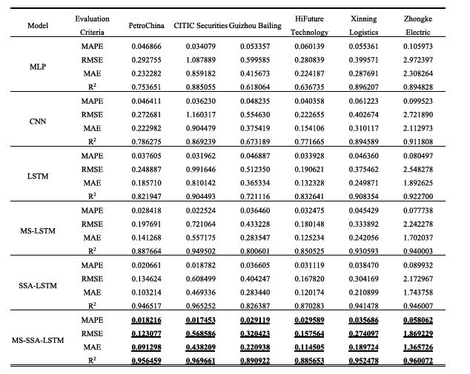
Performance Matrix Comparision: The table below summarizes key performace metrics---MAPE,RMSE,MAE AND R SQUARE, for various models. The MS-SSA-LSTM model outperforms others including MLP,CNN AND STANDARD LSTM models, with lower error values and higher R-Square scores indicating superior predictive accuracy and model fit.

Slide 18

Future Enhancements
1
Refinement of Sentiment Analysis
Improving the sentiment analysis model to better capture nuanced emotions and opinions.
2
Expansion of Data Sources
Incorporating additional data streams to enhance the breadth and depth of the predictive model.
3
Incorporation of External Factors
Analyzing the impact of macroeconomic, geopolitical, and other external variables on stock price movements.
4
Global Market Adaptability
Evaluating the model's performance and applicability across different international stock markets.

Slide 19

Conclusion
Integrates sentiment analysis and deep learning for accurate stock
price prediction.
1
Key Findings
The model demonstrated a 10.74% average improvement in
R² over standard LSTM models.
2
Deep Learning's Role
Captures complex market dynamics.
3
Future Research Directions
Provides a framework for future financial forecasting research.
4
Overall Impact
Improves stock market prediction and investment decisions.
5
Contribution to Financial Research
Advances the field of sentiment analysis and deep learning for finance.

Slide 20
REFERENCES
1). A. Hossain and M. Nasser, ‘‘Recurrent support and relevance vector machines based model with application to forecasting volatility of financial returns,’’ Journal of Intelligent Learning Systems and Applications, vol. 3, no. 4, pp. 230–241, 2011
2). A. H. Moghaddam, M. H. Moghaddam, and M. Esfandyari, ‘‘Stock market index prediction using artificial neural network,’’ Journal of Economics, Finance and Administrative Science, vol. 21, no. 41, pp. 89–93, Dec. 2016
3) Shiller, R. J. (2015). Irrational Exuberance. Princeton University Press.
4). Malkiel, B. G. (2015). A Random Walk Down Wall Street: The Time-Tested Strategy for Successful Investing. W. W. Norton & Company.
5) Thaler, R. H. (2016). Behavioral Economics: Past, Present, and Future. The American Economic Review, 106(7), 1577-1600.
6) G. Ding and L. Qin, ‘‘Study on the prediction of stock price based on the associated network model of LSTM,’’ International Journal of Machine Learning and Cybernetics, vol. 11, no. 6, pp. 1307–1317, Nov. 2019.

